Slide 1
Web Engineering
Lecture-11

Slide 2
Lecture Outline
Sending E-mails
Text E-mails
HTML E-mails
Attachment with E-mails

Slide 3
Sending E-mails

Slide 4
Sending E-mails
Sending email messages is very common for a web application, for example:
Sending a welcome email when a user create a new account on your website
Sending newsletters to your registered users
Getting user feedback or comment through the website's contact from and many more
mail(to, subject, message, headers, parameters)

Slide 5
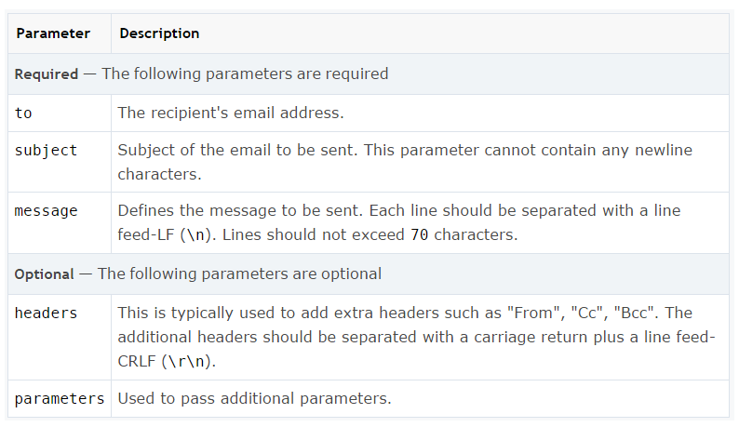
Sending E-mails

Slide 6
Sending Plain Text E-mails
The simplest way to send an email with PHP is to send a text email.
<?php
$to = "beeedoo@gmail.com";
$subject = "Welcome to Arid";
$message = "Hi ABC, You are welcome to Join Arid University.";
// Setting Headers
$headers = "From: naveed.qamar@hotmail.com \r\n Reply-To: naveed.qamar@hotmail.com " ;
// Sending email
if(mail($to, $subject, $message,$headers)){
echo 'Your mail has been sent successfully.';
} else{
echo 'Unable to send email. Please try again.';
}
?>

Slide 7
Sending HTML E-mails
When you send a text e-mail using PHP then all the content will be treated as simple text. Even if you will include HTML tags in a text message, it will be displayed as simple text and HTML tags will not be formatted according to HTML syntax.
PHP provides option to send an HTML message as actual HTML message.
$headers = "Content-type: text/html; charset=UTF-8 \r\n";

Slide 8
Sending HTML E-mails
<?php
$to= "beeedoo@gmail.com";
$subject= "Welcome to Arid";
$message= "Hi XYZ,<br> You are welcome to Join Arid University.<br>Regards, <br> Arid University";
// Setting Headers
$headers="From:naveed.qamar@hotmail.com\r\n Reply-To: naveed.qamar@hotmail.com \r\n " ;
$headers.="Content-type: text/html; charset=UTF-8 \r\n";
// Sending email
if( mail($to, $subject, $message,$headers) ) {
echo 'Your mail has been sent successfully.';
} else {
echo 'Unable to send email. Please try again.';
}
?>

Slide 9
Sending E-mail with Attachment
To send an e-mail with attachment use following headers
MIME-Version: 1.0 i-e used when you're sending an e-mail that contains one of the following:
Text in character sets other than ASCII.
Non-text attachments.
Message bodies with multiple parts.
Content-Type:multipart/mixed;boundary=uniquestring
Multipurpose Internet Mail Extensions (MIME)
See Example mail4.php

Slide 10
Sending E-mail with Attachment
// message
$message.= "--".$boundry. "\r\n ";
$ message.= "Content-type: text/html; charset=UTF-8 \r\n ";;
$ message.= $msg.$eol;
// attachment
$ message.= "--".$boundry "\r\n ";
$ message.= "Content-Type: application/octet-stream; name=\"".$filename."\" \r\n ";
$ message.= "Content-Transfer-Encoding: base64 \r\n ";
$ message.= "Content-Disposition: attachment \r\n \r\n ";
$ message.= $attachment \r\n ";
$ message.= "--".$ boundry."--";
See Example mail4.php

