Slide 1
Web Engineering
Lecture-06

Slide 2
Lecture Outline
Content Modeling
Navigation Modeling
Presentation Modeling

Slide 3
Content Modeling

Slide 4
Content Modeling
The information provided by a web application is one of the most important factors for the success of that application.
Content modeling aims at modeling the content requirements of a web application.
Diagraming the structural and behavioral aspects of the information.
Ignores the navigational information
Key UML Diagrams
Class diagram: to model the structural aspects of information
State machine diagram: to model behavioral aspects of information

Slide 5
Content Modeling
Class Diagram describes the structure of a system by
system’s classes
class attributes
operations (methods)
relationship among objects

Slide 6
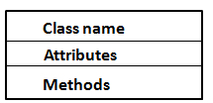
Content Modeling
Class Diagram (Elements)
Class
class is represented by a rectangle with three compartments
name
attributes
methods

Slide 7
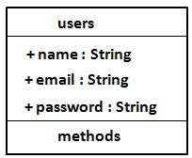
Content Modeling
Class Diagram (Elements)
Attributes
an attribute describes a piece of information that an object owns
specified by name
kind (data type)
visibility (+, - , #)
default value
visibility name : type= default value
+ name : string = ‘ali’ {maximum 25 characters}

Slide 8
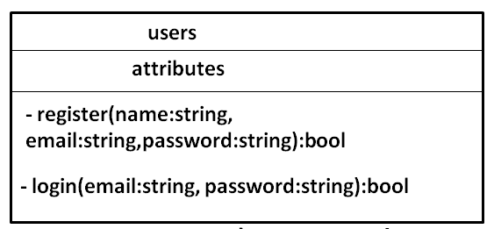
Content Modeling
Class Diagram (Elements)
Methods
behaviors (things objects can do or can be done with them)
name
arguments
visibility (+, - , #)
return value
visibility name (argument_name:type): return_value
+ userLogin(email:string, password:string):null

Slide 9
Content Modeling
Class Diagram (Elements)
Association
relationship between classes
name of relationship
visibility (+, - , #)
direction of relationship
Association multiplicity
How many objects participating in the relation

Slide 10
Content Modeling
Class Diagram (Elements)
Aggregation relation
class has features of another class plus some own features
Composition relation

Slide 11
users
1..1
Video Sharing
0..*
- name : string
-email : string
-password : string
-introduction : string
1..1
-register
-login
0..*
user
uploads
0..*
Register user
video
-videoID : int
+videoTITLE : string
+videoDES : string
+upload()
+search()
0..*

Slide 12
Content Modeling
State Machine Diagram
For dynamic Web applications, they depict important states and events of objects, and how objects behave in response to an event (transitions)
Show the life-cycle of an object
Used only for state-dependent objects

Slide 13
Uploaded
Search
Watch

Slide 14
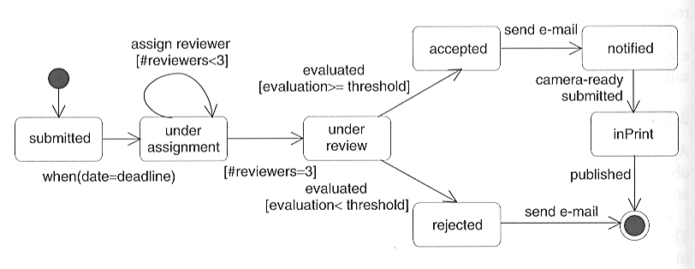
Second state
Fourth state
Third state
First state
Fifth state

Slide 15
Navigation Modeling

Slide 16
Navigation Modeling
Models how web-pages are linked together
defines the structure of the hypertext
Which classes of the content model can be visited by navigation
http://uwe.pst.ifi.lmu.de/teachingTutorialNavigation.html
UWE navigation modeling
navigationClass
Menu
Index
Query
processClass
Processlink
Navigation link
External link

Slide 17
Navigation Modeling
Online video sharing
Home page
video list
search video
upload video
Register
login
Upload

Slide 18
<<navigationClass>>
Video Sharing
<<processlink>>
<<menu>>
mainMenu
<<navigationlink>>
<<query>>
searchVideo
<<navigationLink>>
<<navigationClass>>
uploadVideo
<<processLink>>
<<index>>
videolist
<<processlink>>
<<processlink>>
<<navigationlink>>
<<processClass>>
register
<<processClass>>
login
<<processClass>>
upload
<<processlink>>

Slide 19
Presentation Modeling

Slide 20
Presentation Modeling
Purpose: To model the look & feel of the Web application at the page level
The design should aim for simplicity and self-explanation
Describes presentation structure:
Composition & design of each page

Slide 21
Presentation Modeling
Presentation Modeling Levels:
Presentation Page
page container
Presentation Unit
A fragment of the page logically defined by grouping related elements
Presentation Element
A unit’s informational components
Text, images, buttons, fields

Slide 22
