Slide 1
Web Engineering
Lecture-05

Slide 2
Lecture Outline
QUIZ 1
Fundamentals of Web Application Modeling
Requirements Modeling of Web Application

Slide 3
QUIZ 1
MCS-3 (Morning)
List and describe product based characteristics of a Web Application?
Duration: 20 min

Slide 4
QUIZ 1
MCS-3 (M)
List and describe product based characteristics of a Web Application?
Duration: 15 min

Slide 5
QUIZ 1
MCS-3 (EVening)
List and describe usage based characteristics of a Web Application?
Duration: 15 min

Slide 6
Fundamentals of Web Application Modeling

Slide 7
Fundamentals of Web Application Modeling
Modeling is aimed at providing a specification of a system to be built in a degree of detail sufficient for that system’s implementation.
A model represents the relevant aspects of the system in a simplified and – ideally – comprehensible manner.
System Modeling is the process of developing abstract models of a system.
That means representing system using graphical notations
UML

Slide 8
Fundamentals of Web Application Modeling
Models are used during
RE phase to derive system requirements
use-case diagram, activity diagram
Design phase to describe the system to engineers
class diagrams, sequence diagrams etc
After implementation
to document system’s structure and operation

Slide 9
Fundamentals of Web Application Modeling
Why application modeling?
Requirements elicitation and documenting
Reduce complexity
Document design decisions
Facilitate communication among team members

Slide 10
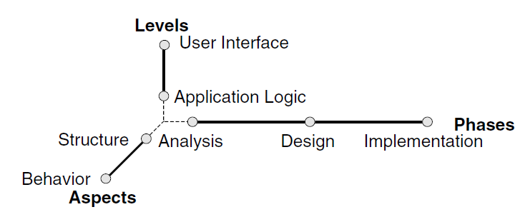
Fundamentals of Web Application Modeling
Modeling dimensions of Traditional Application
Levels – the “how” & “what” of an application
Aspects – objects, attributes, and relationships; function & processes
Phases – Development cycle
.

Slide 11
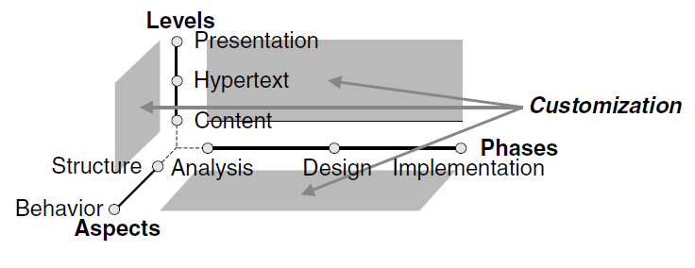
Fundamentals of Web Application Modeling
Modeling dimensions of Web Application
Levels – Information, node/link structure, UI & page layout separate.
Aspects – Same as Software Applications
Phases – Approach depends upon type of application
Customization – Context information (user’s preferences, bandwidth restriction, device characteristic etc.) and allow to adopt web application accordingly Influence other three dimensions
.

Slide 12
Fundamentals of Web Application Modeling
UML?
“The Unified Modeling Language is a visual object oriented language for specifying and documenting the artifacts of systems”
UML allows to specify the aspects of a software system in the form of models, and uses various diagrams to represent them graphically.
UML has two types of diagrams:
structural diagrams such as class diagrams, component diagrams, composite structure diagrams, and deployment diagrams
behavioral diagrams, such as use case diagrams, state machine diagrams, and activity diagrams
For Web-centric modeling, UML is used with some extensions from UWE (UML-based web engineering)
http://uwe.pst.ifi.lmu.de/

Slide 13
Fundamentals of Web Application Modeling
Modeling Requirements
Use-case diagram
Activity diagram
Modeling Content
Class diagram
State machine diagram
Hypertext Modeling
To model nodes and navigational structure among them
Presentation Modeling
Model user interface, page-layout
Modeling activities for Web Application

Slide 14
Requirements Modeling of Web Application

Slide 15
Requirements Modeling of Web Application
Use cases are the preferred modeling technique for functional requirements.
The overall functionality of a Web application is modeled as a set of use cases, which describe the Web application requirements from the actors’ (people and other systems) perspectives.
Additionally, use cases can be supplemented by UML activity diagrams to describe the functional requirements in more detail.

Slide 16
Requirements Modeling of Web Application
One peculiarity of Web application requirements is navigation functionality, which allows the user to navigate through the hypertext and to find nodes.
Therefore, for web application separate functional use cases from navigational use cases.

Slide 17
Requirements Modeling of Web Application
Use-case Diagram: The goal of the diagram is to provide a high-level explanation of the relationship between the system and the outside world (set goals).
Activity diagram: a graphical representation of workflows of stepwise activities and actions with support for choice, iteration and concurrency.

Slide 18
Requirements Modeling of Web Application
Use-case Diagram (Components)
The system
The use case task referred to as the use case that represents a feature needed in a software system
System Name
Use-case title

Slide 19
Requirements Modeling of Web Application
Use-case Diagram (Components)
The actor(s) who trigger the use case to activate.
The communication line to show how the actors communicate with the use case.
<<actor>>
HR system

Slide 20
Requirements Modeling of Web Application
Use-case Diagram (Components)
The include relationship represents the inclusion of the functionality of one use case within another.
The extend relationship represents the extension of the use case to include optional functionality.
<<include>>
include use-case
base use-case
<<extend>>
Base use-case
Extension use-case

Slide 21
Requirements Modeling of Web Application
Use-case Diagram (Components)
A use-case-generalization is a relationship from a child use case to a parent use case, specifying how a child can specialize all behavior and characteristics described for the parent.
Generalized
Specialized
Registered user
user

Slide 22
Requirements Modeling of Web Application
Use-case Diagram (Components: Web Specific)
UWE provides <<browsing>> to represent a navigational use-case while <<processing>> to represent a functional use-case

Slide 23
Requirements Modeling of Web Application
Use-case Diagram (Example)
Consider an online video sharing system:
Users can search and view the videos
A user must be a register user to share videos

Slide 24
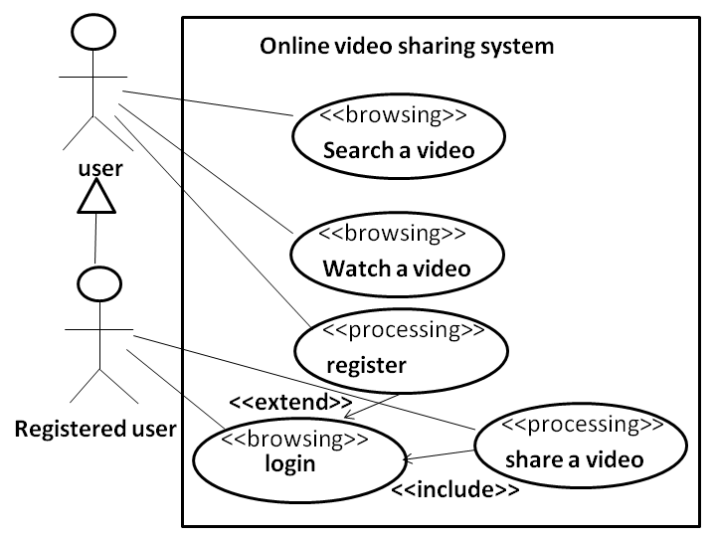

Slide 25
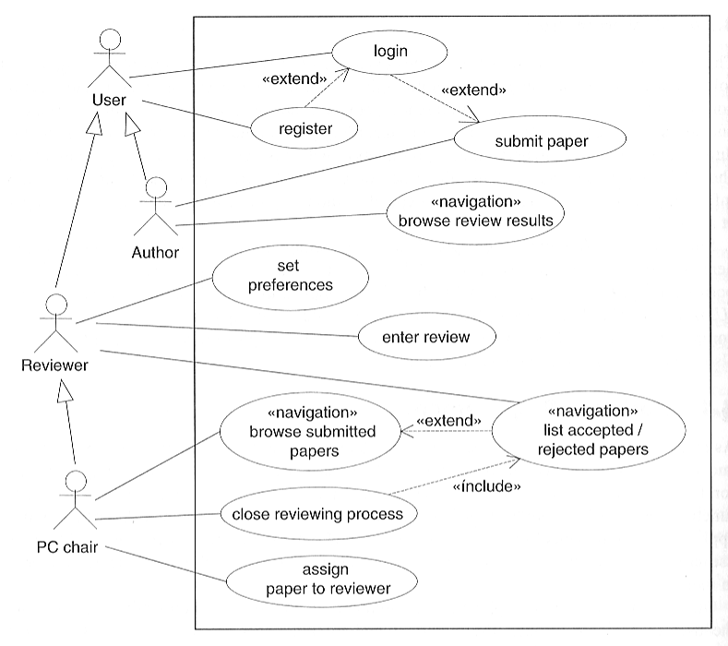

Slide 26
Requirements Modeling of Web Application
Activity Diagram (Elements)
An activity is a step in a process where some work is getting done.
The transition takes place because the activity is completed
activity
Read a page
Turn the page

Slide 27
Requirements Modeling of Web Application
Activity Diagram (Elements)
A guard condition can be assigned to a transition to restrict use of the transition
[get driving license]
Learn driving
Drive the car

Slide 28
Requirements Modeling of Web Application
Activity Diagram (Elements)
Decision
Merge Point
Start and end

Slide 29
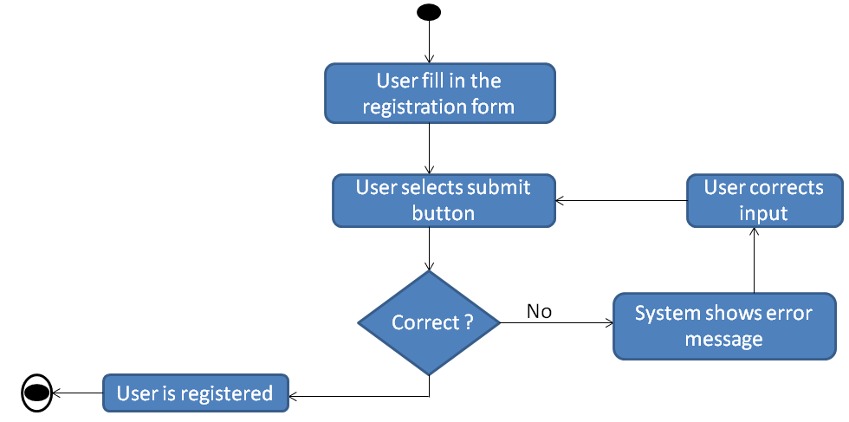

Slide 30
Requirements Modeling of Web Application
Activity Diagram (Elements: Web Specifics)
UWE activity diagram elements:
userAction : user’s action or response
systemAction : system’s action
displayAction : display action
navigationAction : navigation
displayPin : output
interactionPin : input

Slide 31
